Slide 1
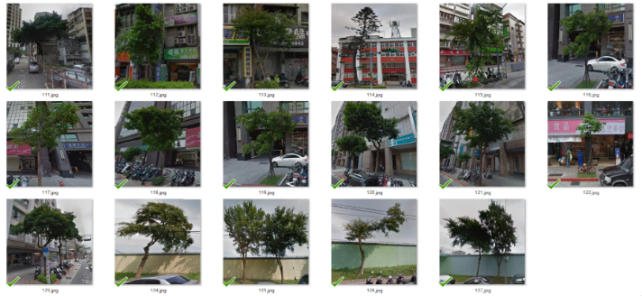
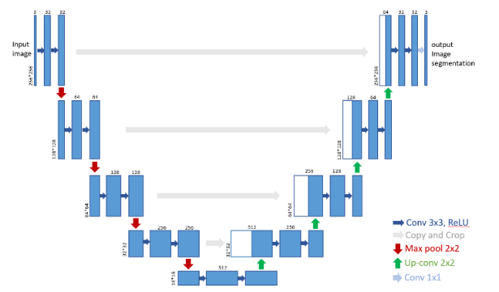
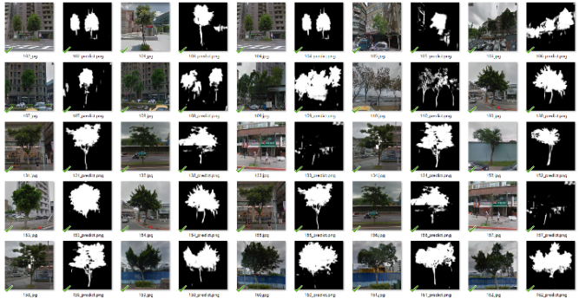
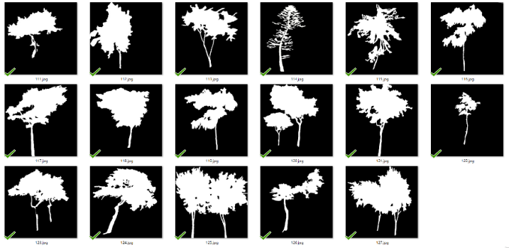
Street Trees Detection Based on Deep Learning and Open Data Hao Chen
Street trees are an indispensable component of great neighborhoods. Trees can be improving environmental quality, representing the style of a city, and strengthening urban amenity. However, it is still difficult to detect trees in arbitrary street images by using conventional image processing methods because uncontrollability of outdoor illumination, variety of colors and textures, overlap and density of leaves, etc.
Nowadays, many countries start promoting open data in cities, especially in smart cities. There are also tremendous amount of geographic data and street images available on Google Map and Google Street View. Therefore, in this research, we propose to integrate the above resource and use Deep Learning to segment trees based on their species. The experiment result shows that our system has the potentials to provide an effective approach for automatically monitoring and managing street trees in smart cities.

Slide 2
行道樹在我們的日常生生活中扮演重要的腳色，可以改善人們生活品質、美化市容。然而，城市大量的行道樹，藉由人力去一一觀察樹況是一件非常費力的事。因此我們在本研究中，用智慧城市所給的樹種以及GPS位置，用人工擷取出我們所要的範圍，再以不同的樹種分別作訓練。往後如有季節變換的時候，就可以藉由城市裡原有的錄影監視器，依樹在畫面所佔之比例，得知影像範圍內此樹的成長狀況。

