Slide 1
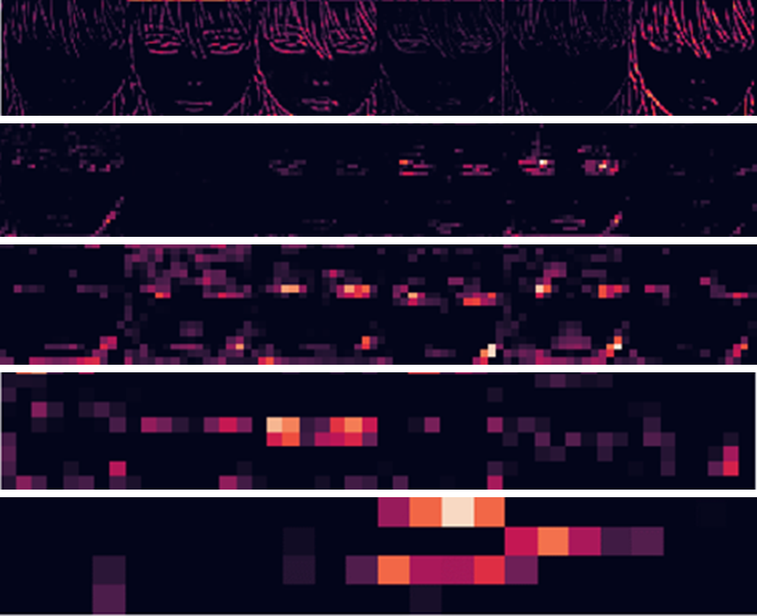
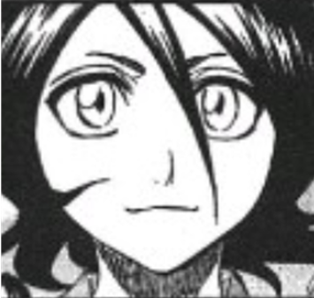
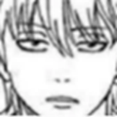
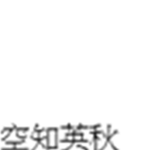
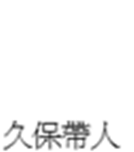
“Manga Artists” Styles Classification based on Deep Learning
Yen-Chia Chen
The huge manga industry of Japan has fostered many great artists. Each famous artist has his/her own creative style. And these painting styles are often expressed in the facial features of comic characters, especially the brushworks of eyes or face contours. Although sometimes human eyes can intuitively and briefly distinguish the comic styles of unique artists, it is still very difficult for computers to automatically recognize these differences.
Therefore, in this research, we proposed a manga artists classification system based on deep learning. About 2000 frontal face pictures of six different manga artists’ works are collected and used as training data. The experiment results show that our system has a recognize rate over 83% among the manga characters of the six artists.
classification
CNN

Slide 2
日本龐大的漫畫產業成就了許多偉大的漫畫作家，各個作家皆有獨特的創作風格與繪畫方式，使得他們的漫畫也各有千秋。而這些畫風特徵常常表現在漫畫人物裡的五官特徵上，特別是眼睛與臉型輪廓的畫法。對於這些繪畫特色，人眼可以大略分辨，卻無法有明確的表達方法來區分各個畫風特色。近年來，對於人臉辨識的技術可說是突飛猛進，但是對於漫畫的人臉來說，由於缺乏人臉照片中應有的顏色、材質、明暗及陰影的資訊，所以如果要使用電腦視覺的手法，例如opencv來對漫畫角色作分析時，很難得到理想的結果。因此，在本研究中我們使用了卷積神經網路，以六位漫畫家筆下作品的正面人臉圖像為訓練資料，藉簡單的網路架構，讓機器能自動分類新的輸入圖片為哪位作家的作品，希望能藉此讓機器尋找並整理出漫畫家各自獨有的繪畫特色。

